Slide 1
Java Microservices with Spring Cloud: Coordinating Services
Introducing Spring Cloud and Microservices Coordination Scenarios

Slide 2
Why are microservices architectures so popular?
Core characteristics of microservices
Coordination challenges that emerge with microservices
Microservices with Spring Cloud
Spring Cloud projects used in this course Capabilities we will add in this course Goals for the course
Prerequisites Summary
Overview

Slide 3


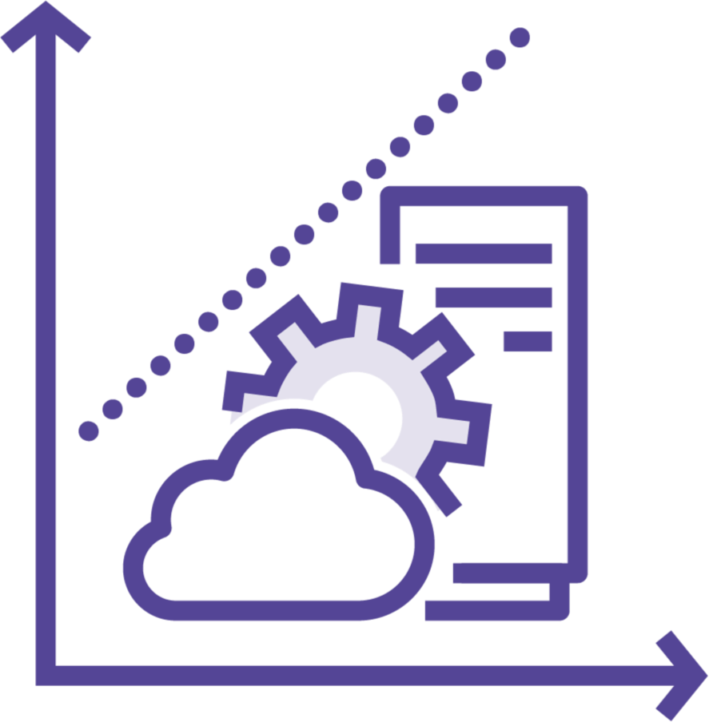

Why are Microservices Architectures Popular?
Desire for faster changes
Need for greater availability
Looking for fine- grained scaling
Compatible with a DevOps mindset

Slide 4
Core Characteristics of Microservices
Components exposed as services
Tied to a specific domain
Loosely coupled
Built to tolerate failure
Delivered continuously via automation
Built and run by independent teams

Slide 5

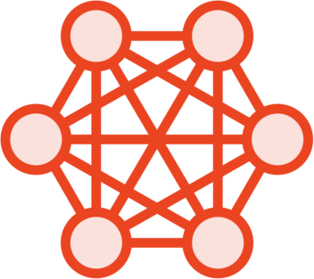


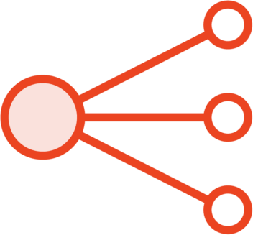

Coordination Challenges that Emerge with Microservices
How do you locate services when hosts change as services get updated or scaled?
How do you reduce single points of failure in a distributed architecture?
Where should you perform load balancing of dynamic services?
How can you dynamically adjust the routing tier?
What can you do to prevent cascading failures when one service starts misbehaving?
What’s a good way to introduce loose coupling to an architecture?

Slide 6

Microservices Scaffolding with Spring Cloud
Released March 2015
Implement common distributed system patterns
Includes industry-standard technologies Fully open source software
Optimized for Spring Boot applications Run it anywhere

Slide 7
Spring Cloud Projects Featured in This Course
Spring Cloud Eureka
Spring Cloud Circuit Breaker
Spring Cloud LoadBalancer
Spring Cloud Gateway
Spring Cloud Stream

Slide 8
Capabilities That We Will Add in This Course
Toll Station UI
 | Service |  | Load Balancer |  | Circuit Breaker
 | Discovery
Toll Data Repository
 | API Gateway
Toll Rate Lookup Service
 | Messaging
Toll Intake Service
Fast Pass Service

Slide 9



Goals for this Course
Recognize challenges and possibilities of coordinating microservices
Get comfortable using leading Spring Cloud projects
Learn how to connect related Spring Cloud projects together

Slide 10

Course Prerequisites
Base knowledge of Java and OOP
Familiarity with Spring framework and Spring Boot
Run a Java-friendly IDE for coding Access to a RabbitMQ and/or Docker

Slide 11
Why are microservices architectures so popular?
Core characteristics of microservices
Coordination challenges that emerge with microservices
Microservices with Spring Cloud
Spring Cloud projects used in this course Capabilities we will add in this course Goals for the course
Prerequisites
Summary

